Slide 1

I.Introducing the topic
1. Ask a problem
The internet is growing to create an environment and a pred before the birth of electronic newspapers.
More convenient than traditional press, large information capacity, faster communicationand information reception.
CIRCLE NEWS

Slide 2
DETAIL
Title
Image,Content
Comment Box
Another post, shared post

Slide 3
Infographic Style
Content Here
You can simply impress your audience and add a unique zing and appeal to your Reports.
Content Here
Content Here
You can simply impress your audience and add a unique zing and appeal to your Reports.
You can simply impress your audience and add a unique zing and appeal to your Reports.
Content Here
Content Here
You can simply impress your audience and add a unique zing and appeal to your Reports.
You can simply impress your audience and add a unique zing and appeal to your Reports.
Content Here
You can simply impress your audience and add a unique zing and appeal to your Reports.

Slide 4

Title
Image, Content

Slide 5
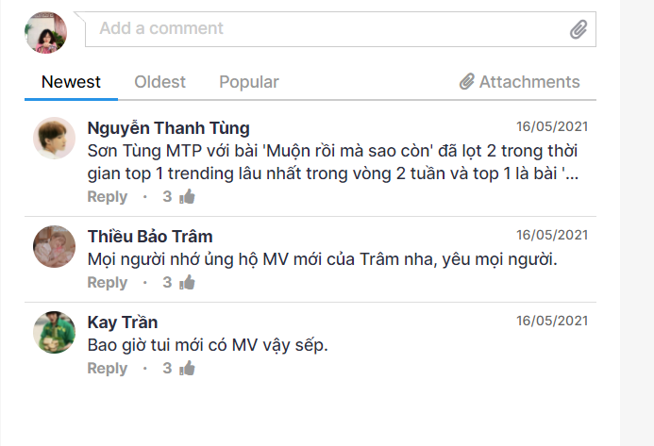
Comment

Slide 6
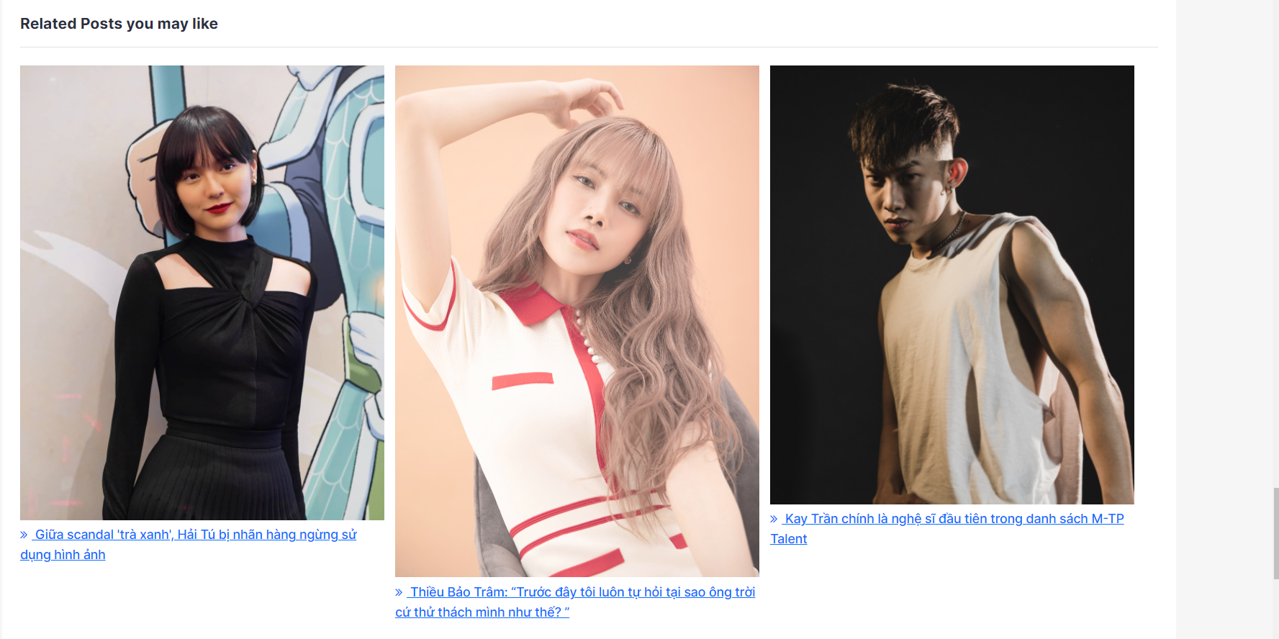
Another post

Slide 7

Another post

